Slide 1
Boise Paper – Wallula
Paper Area of Mill

Slide 2
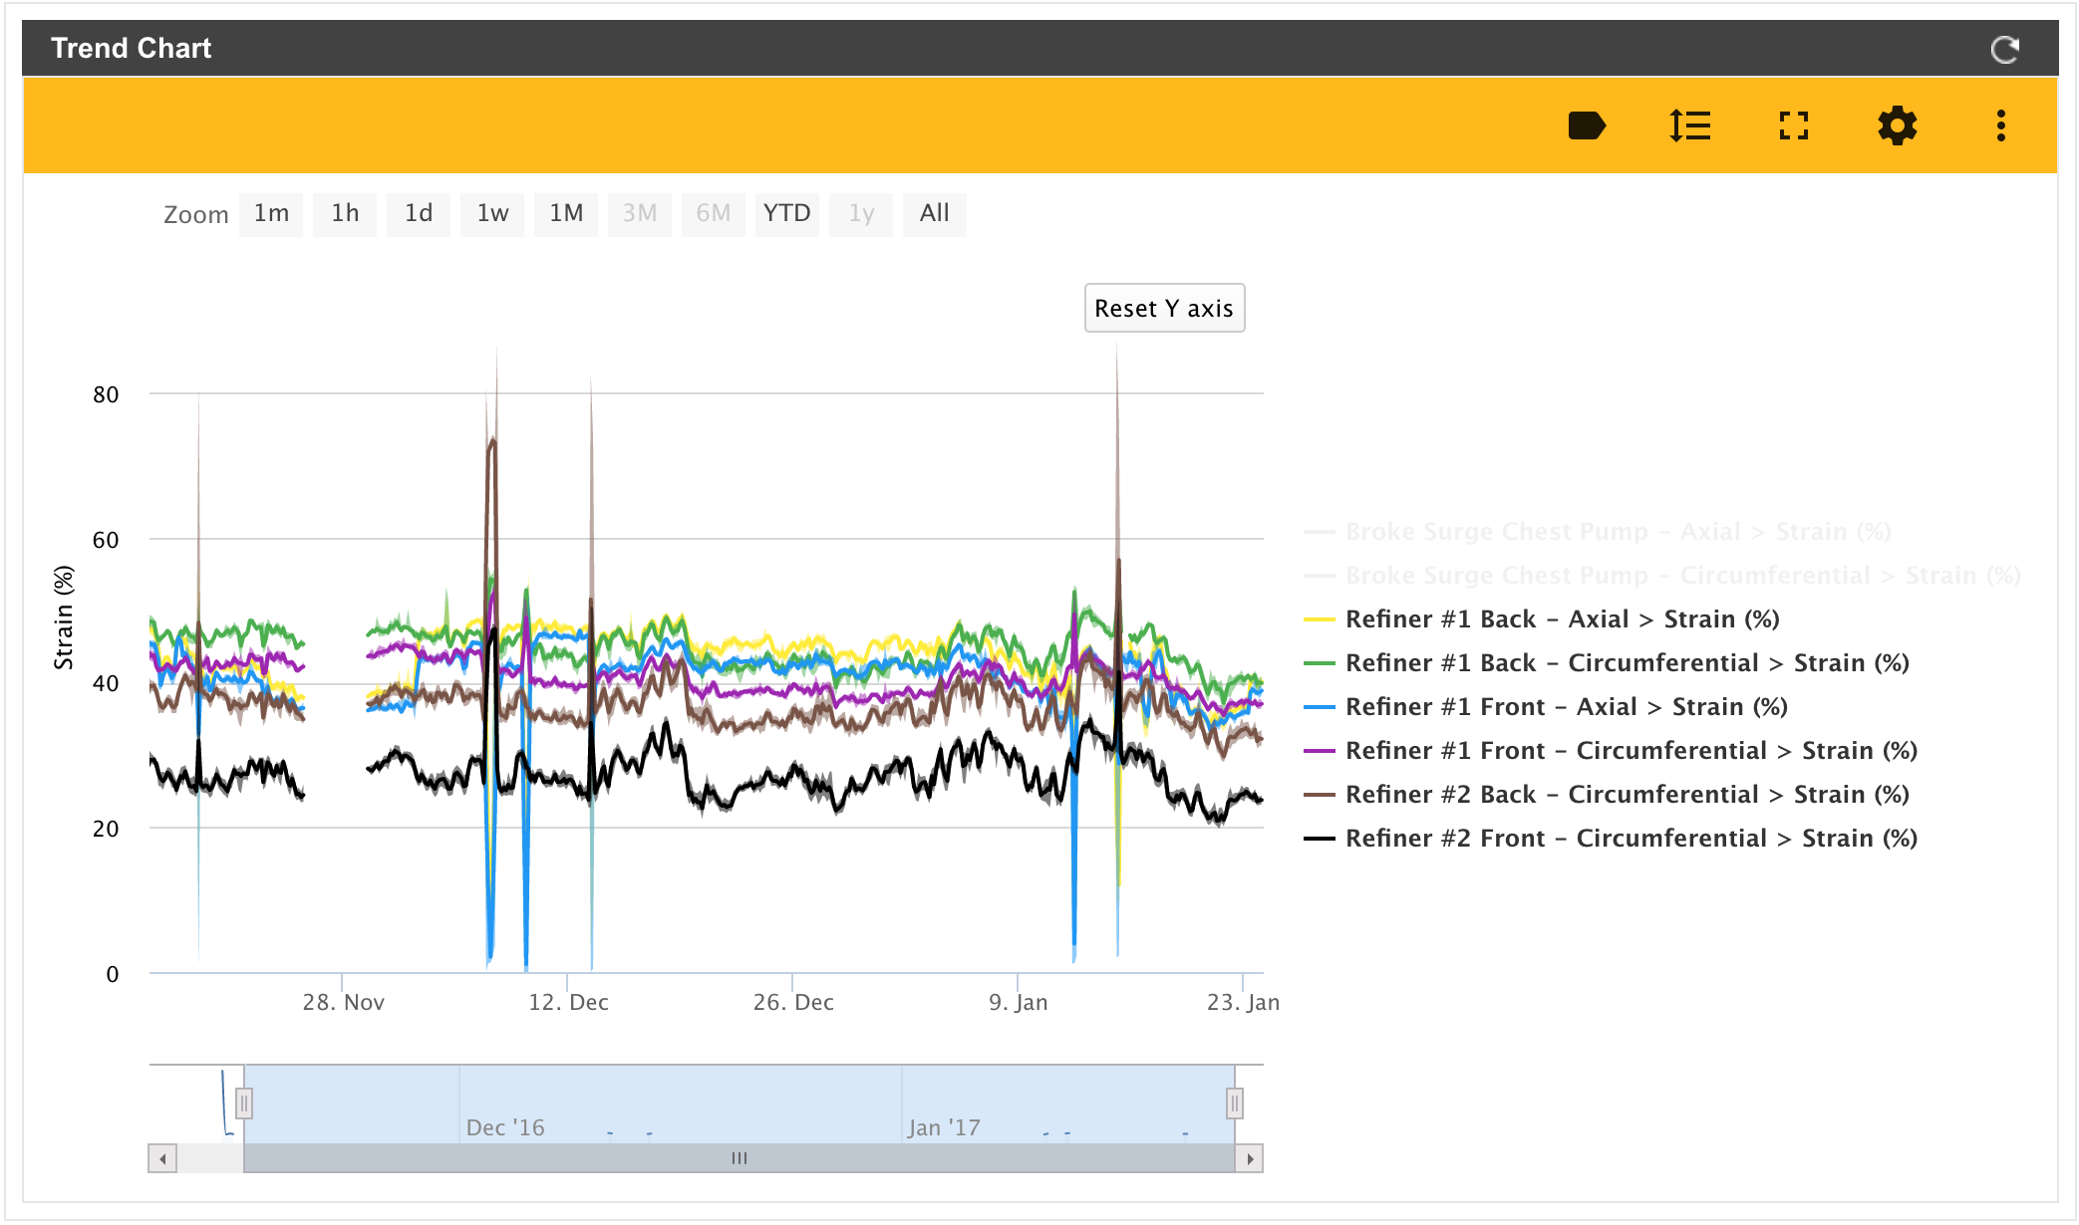
Trend Chart of Customer Data
Trend Chart Data Displayed:
November 14, 2016 to January 23, 2017.
Six Dates Displaying Extremes:
November 19th
December 7th
December 9th
December 13th
January 12th
January 15th
The missing gaps of data are issues with the Exosite database.

Slide 3
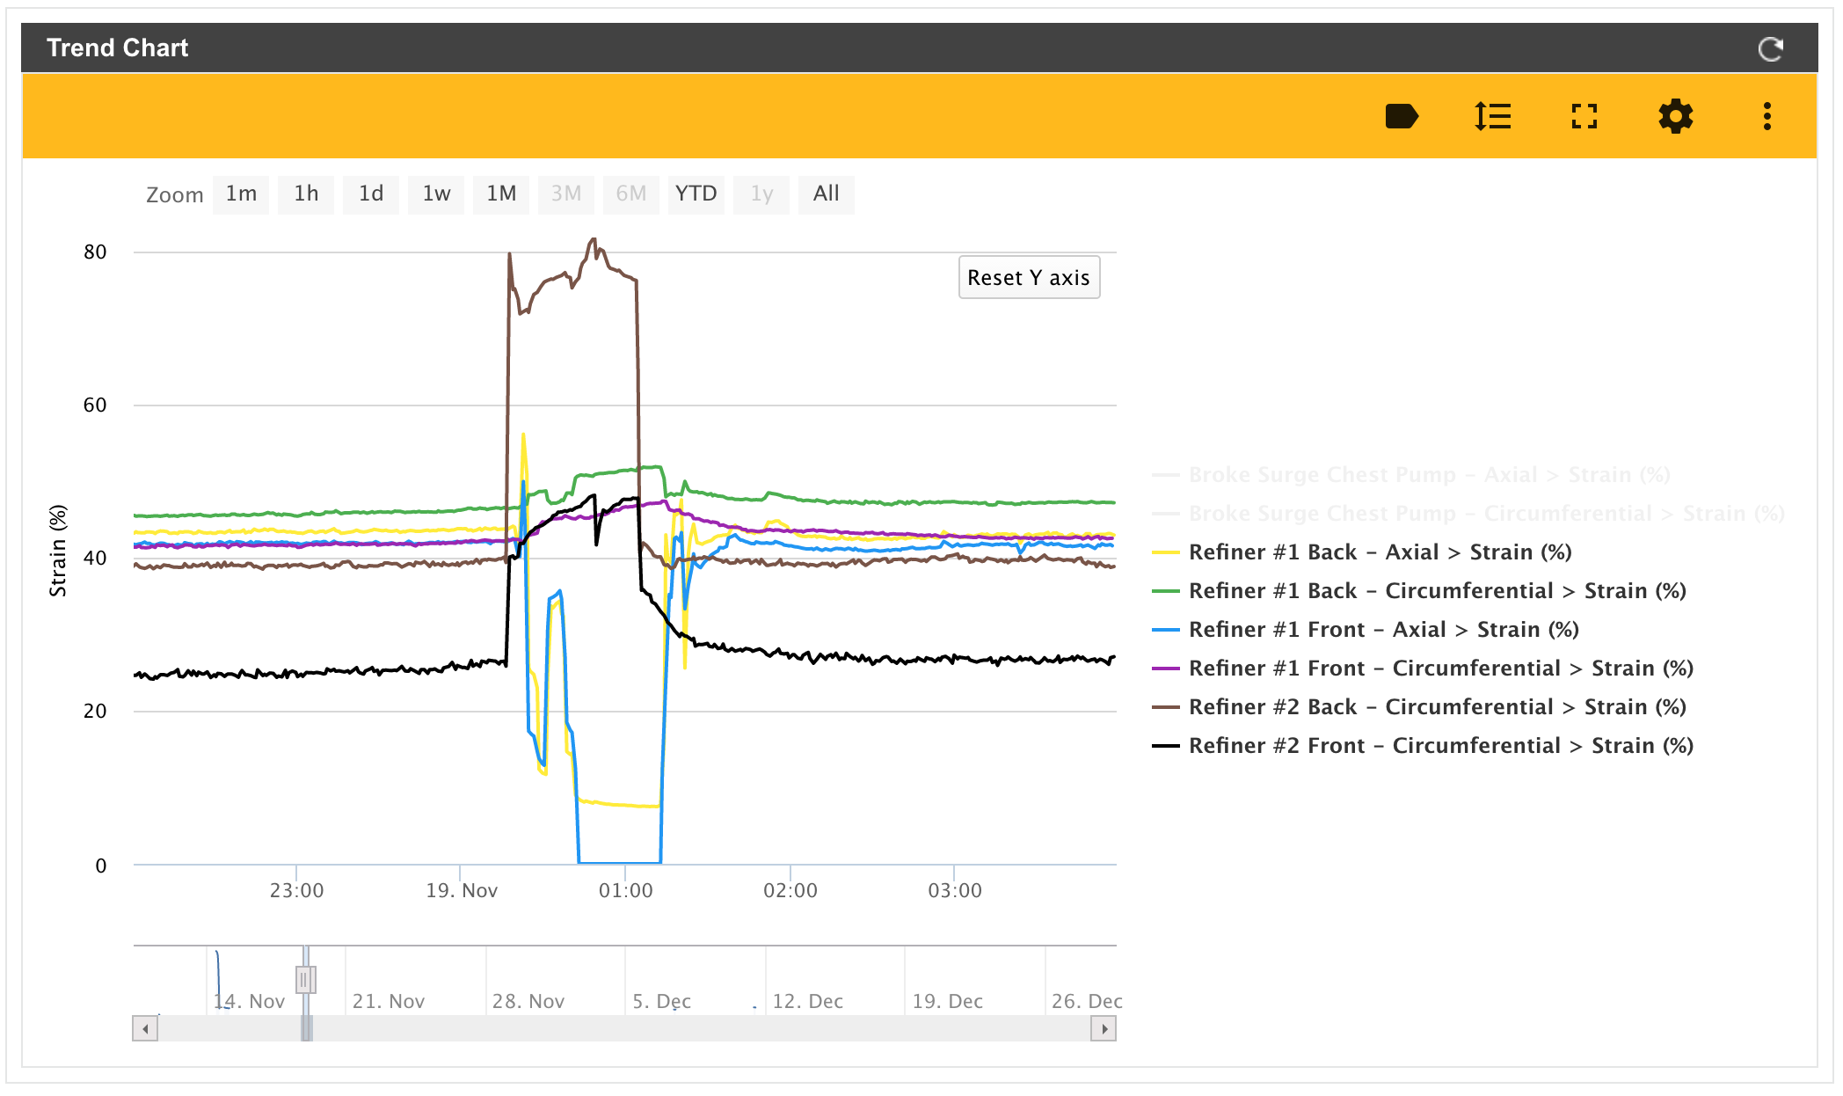
November 19th
Duration of Extreme Section:
1 hour
30 minutes

Slide 4
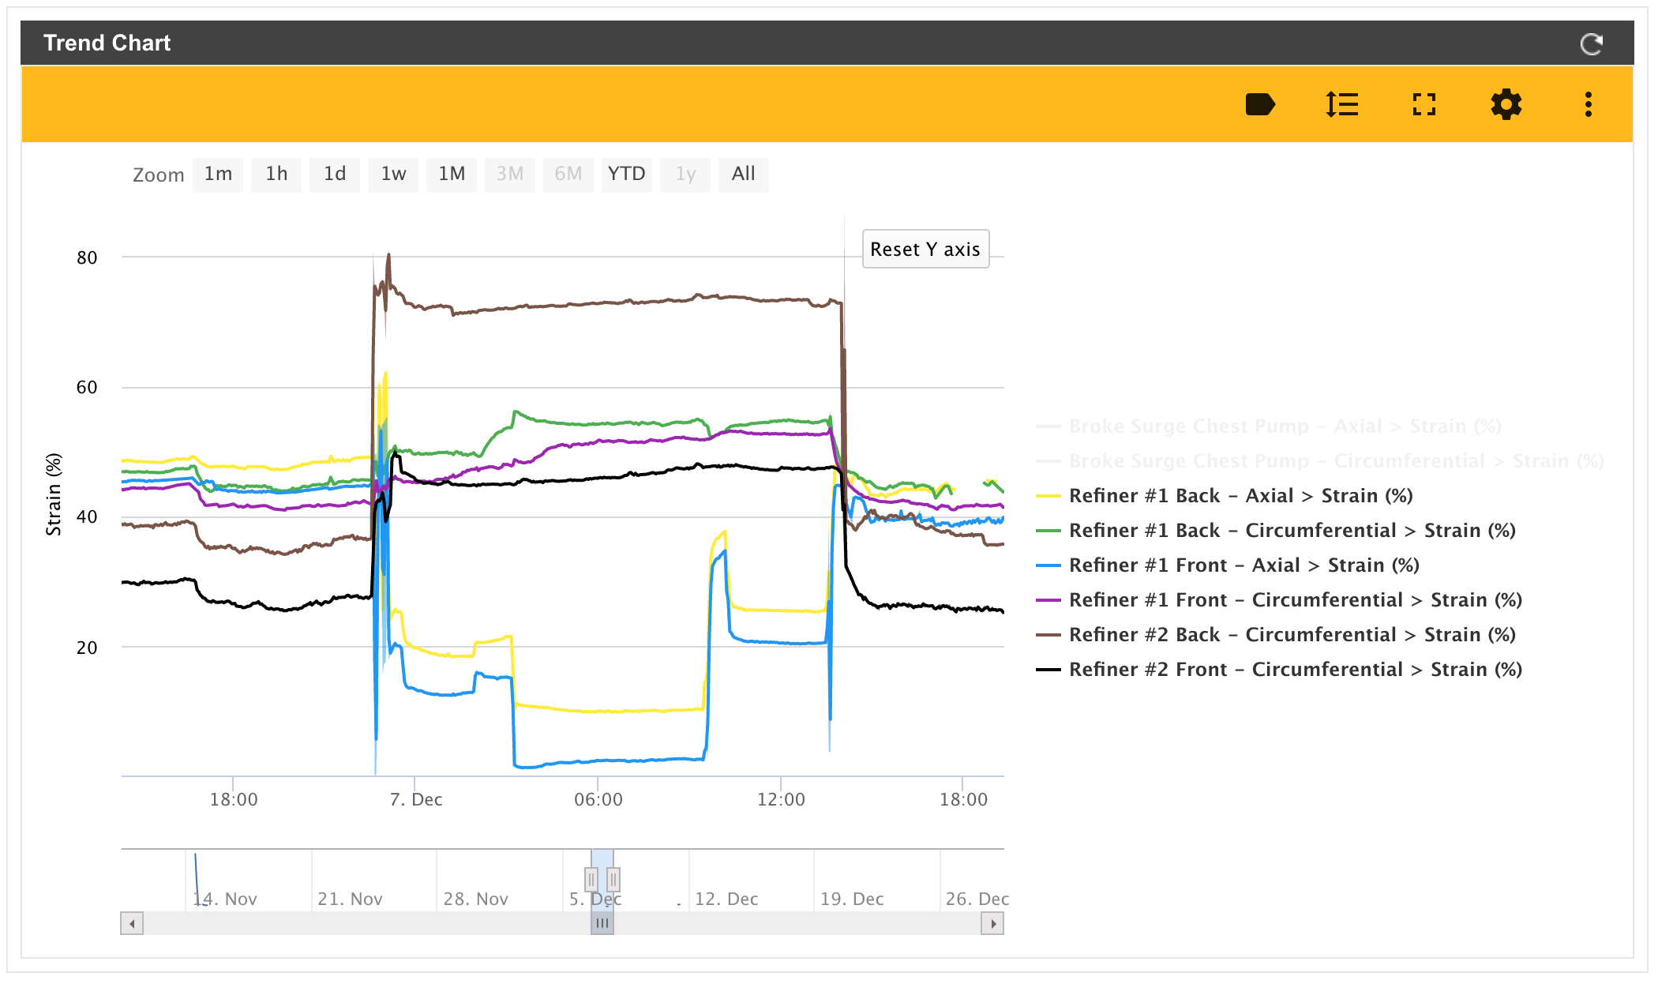
December 7th
Duration of Extreme Section:
16 hours
30 minutes
Duration of Lead-Up Section:
5 hours
45 minutes

Slide 5
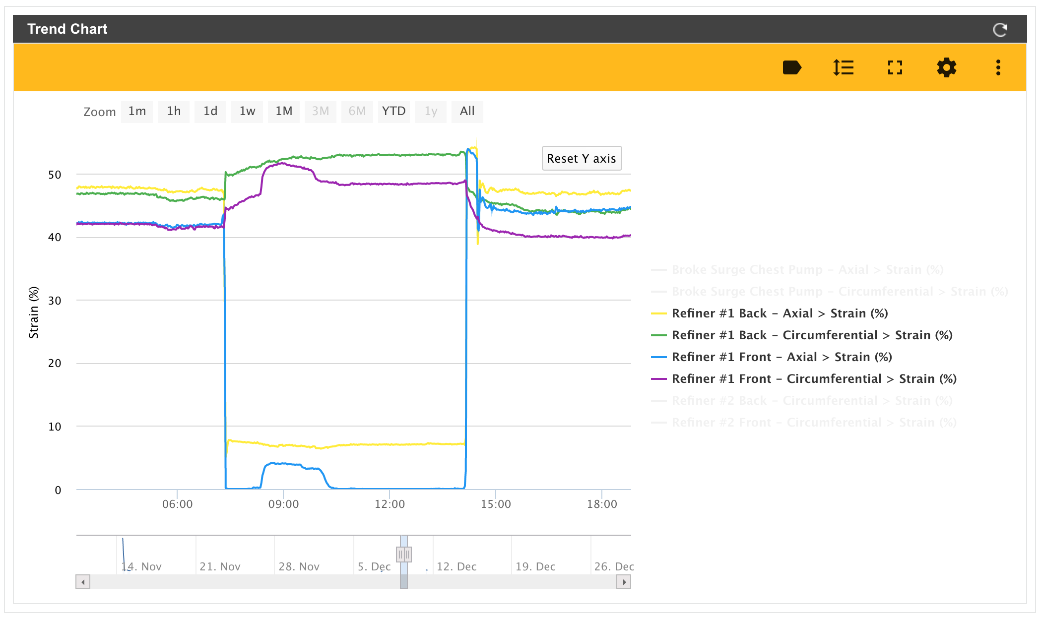
December 9th
Duration of Extreme Section:
7 hours
30 minutes

Slide 6
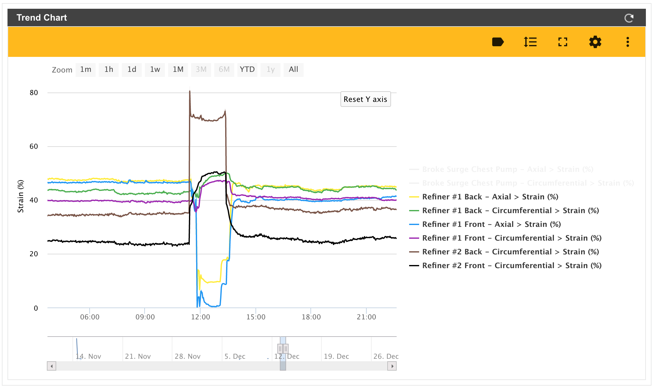
December 13th
Duration of Extreme Section:
2 hours
25 minutes

Slide 7
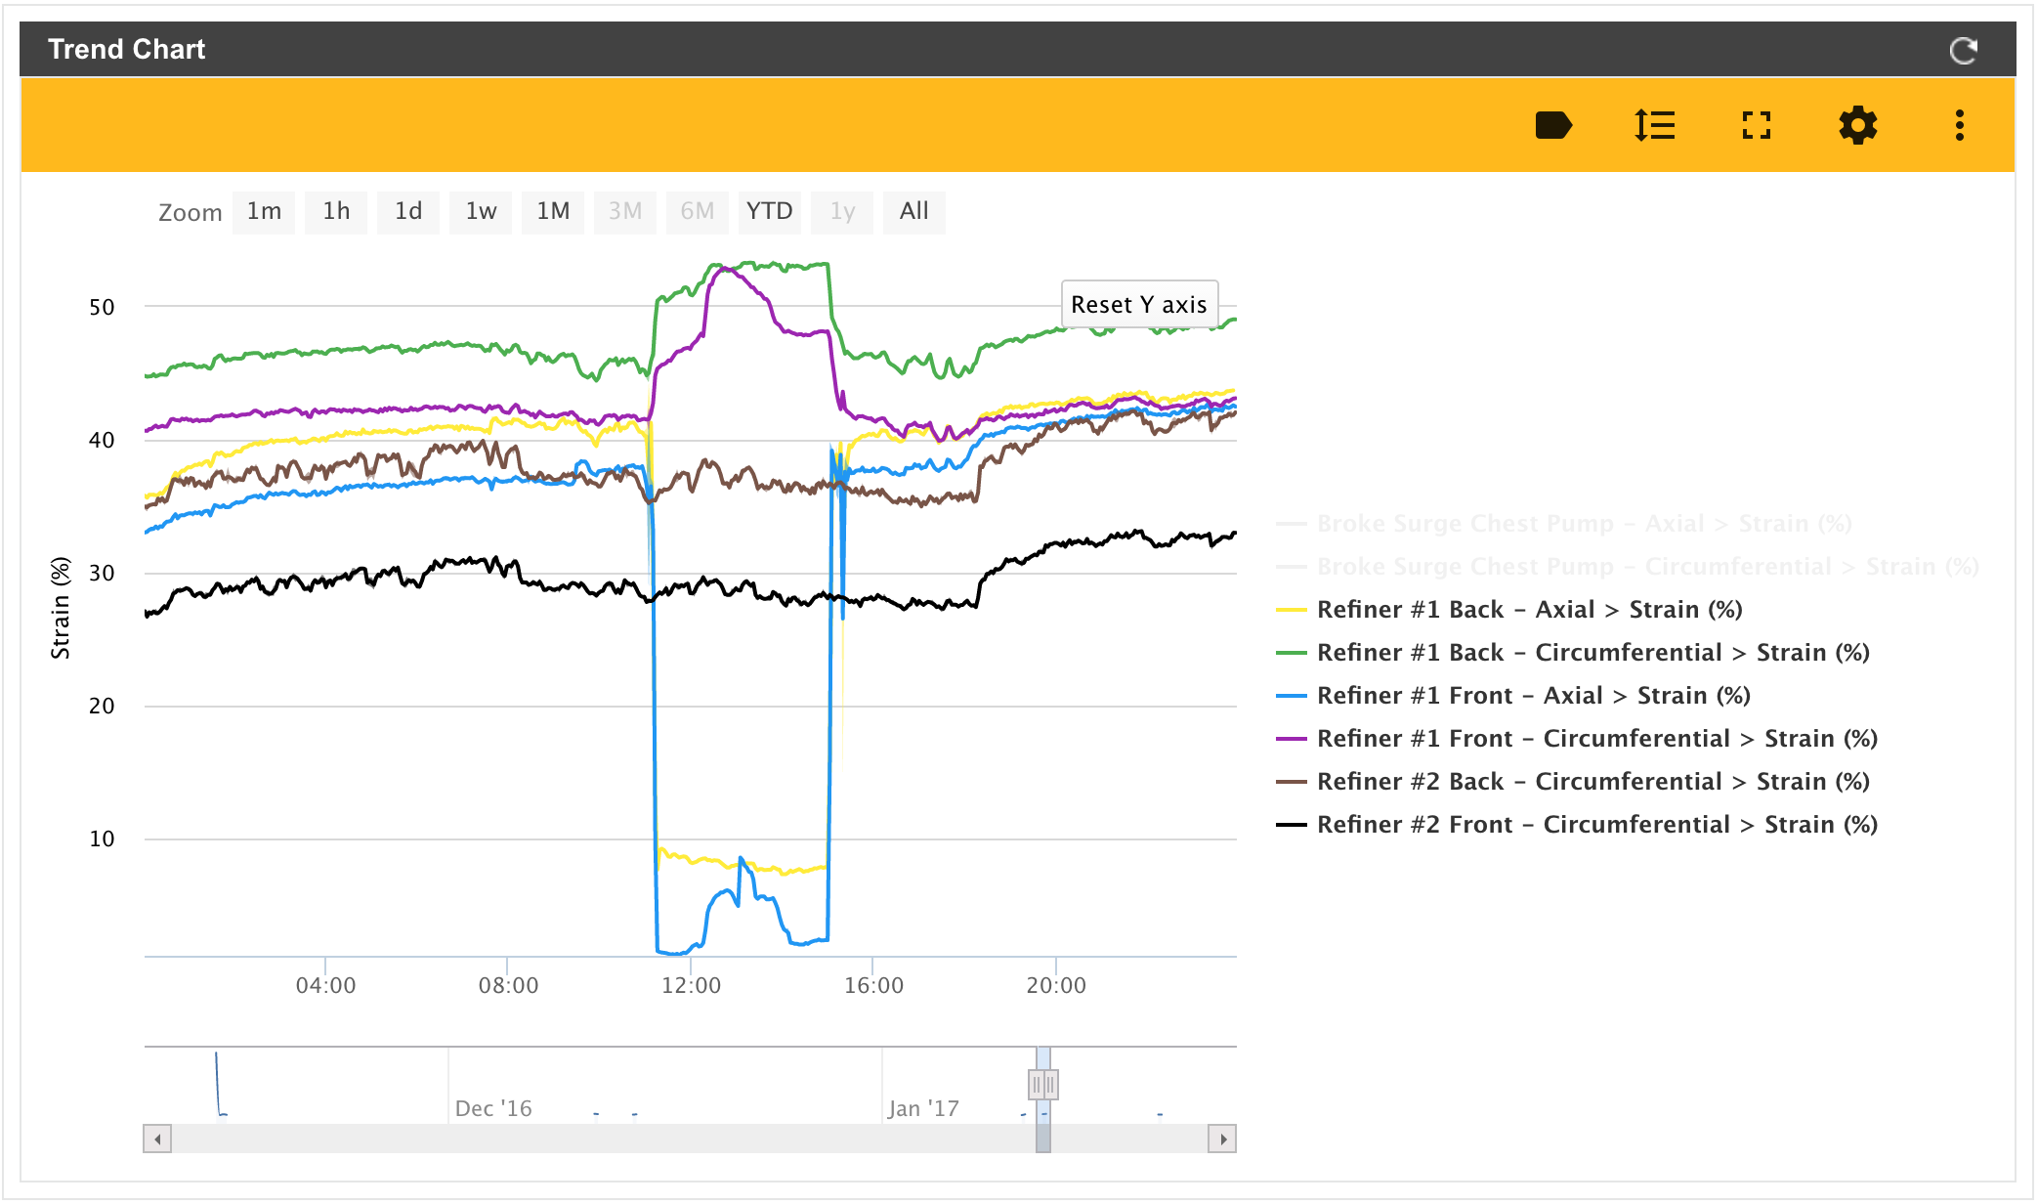
January 12th
Duration of Extreme Section:
4 hours
10 minutes

Slide 8
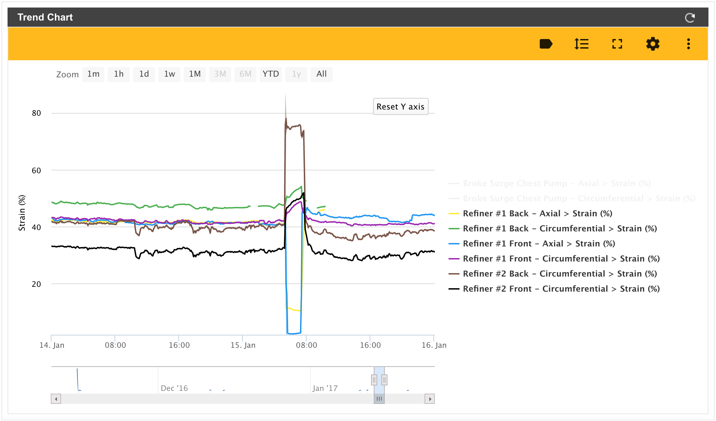
January 15th
Duration of Extreme Section:
2 hours
55 minutes
Duration of Lead-Up Section:
18 hours
45 minutes

Slide 9
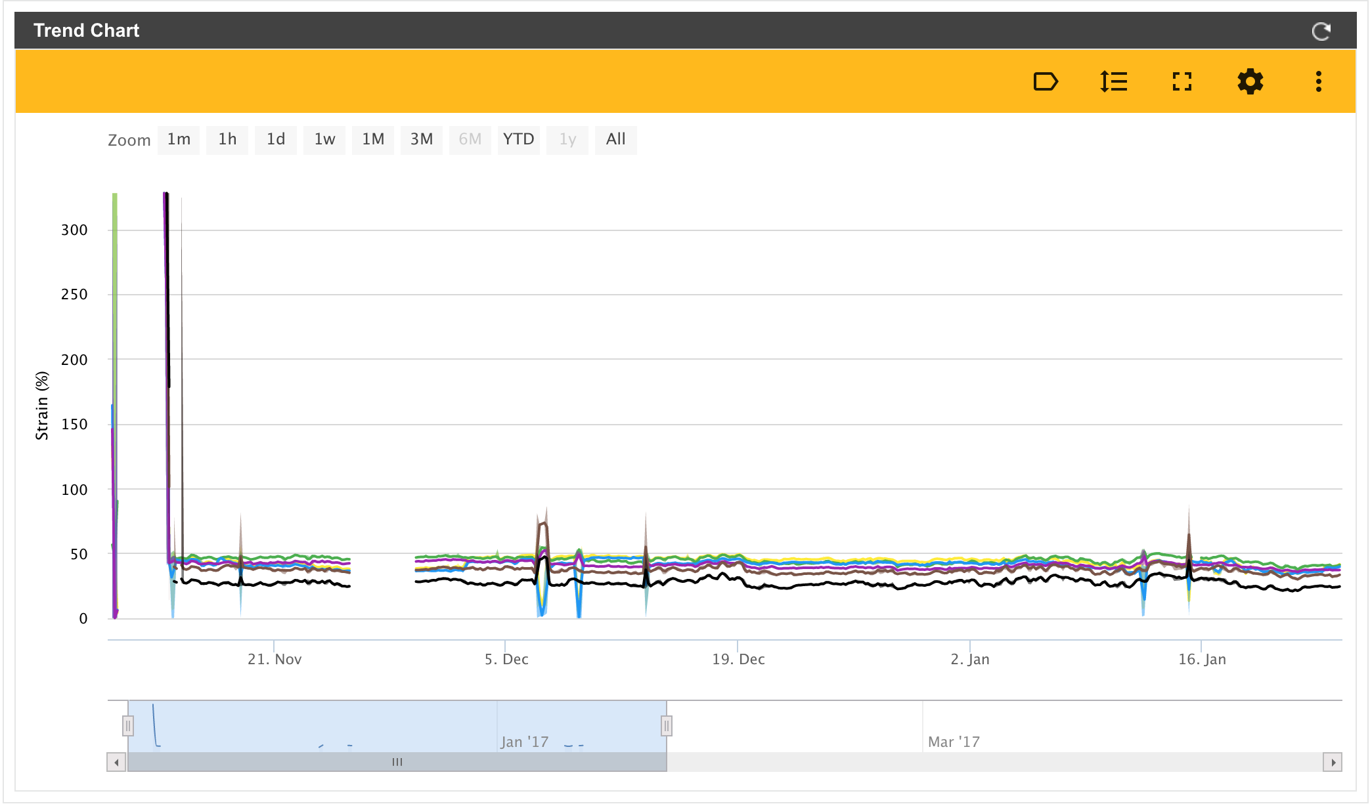
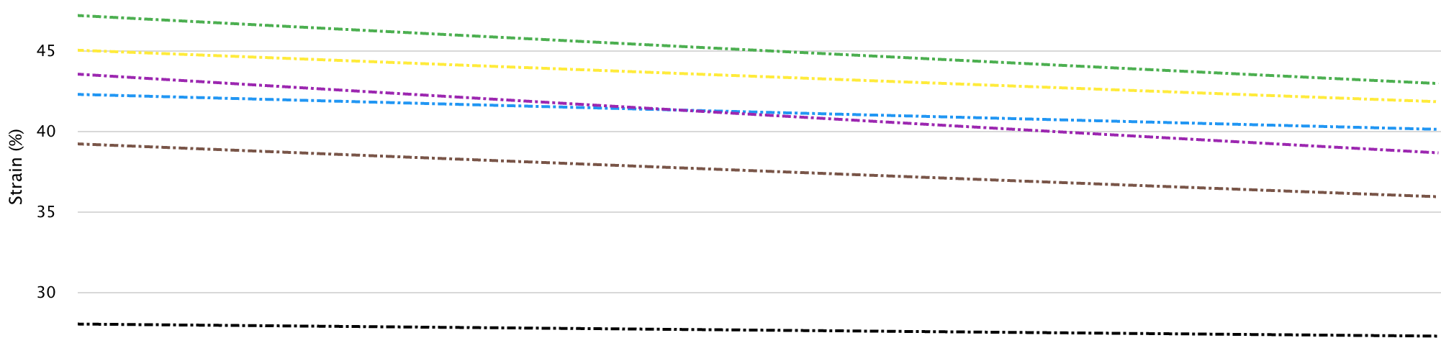
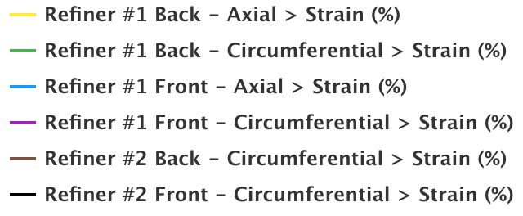
Trend Lines
Sensor | 𝚫 % Strain
#1 Back - A | - 3.29
#1 Back - C | - 4.26
#1 Front - A | - 2.15
#1 Front - C | - 4.90
#2 Back - C | - 3.29
#2 Front - C | - 0.77

Slide 10
Boise Paper – Wallula
Pulp Area of Mill

Slide 11
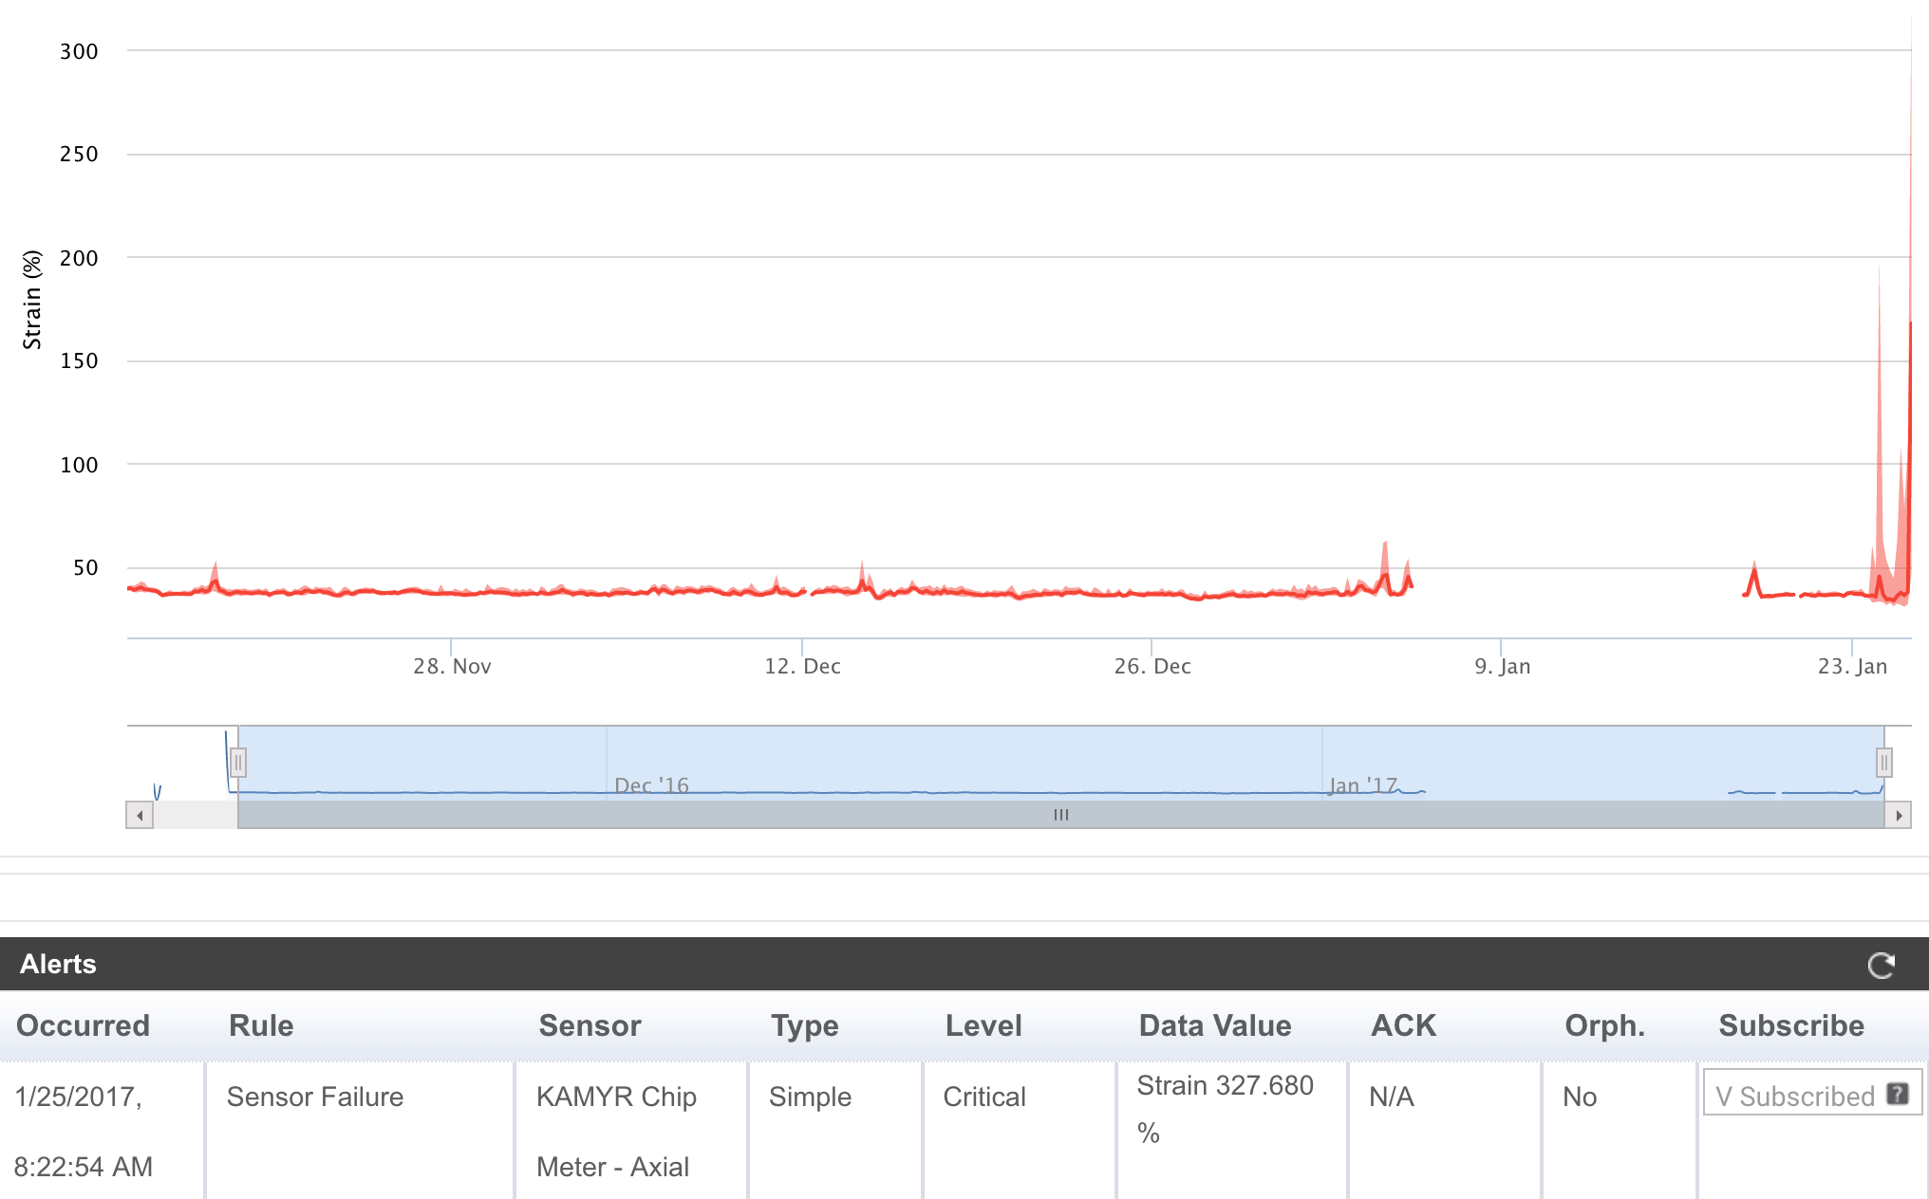
KAMYR Chip Meter
No Data Collected:
January 5th – 18th
Isolated Peaks:
> 45%
Sensor Saturates:
@ 200%
Disconnect / Fail: January 25th, 2017 8:22 AM
No data period

Slide 12
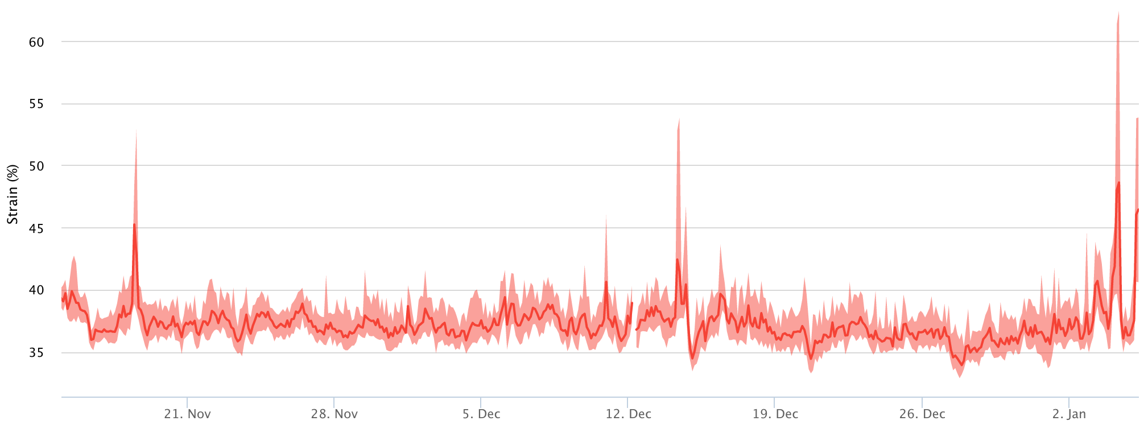
KAMYR Chip Meter before no data period
Data Shown:
November 14th to January 5th
Typical Measurements: 35 – 40%

Slide 13
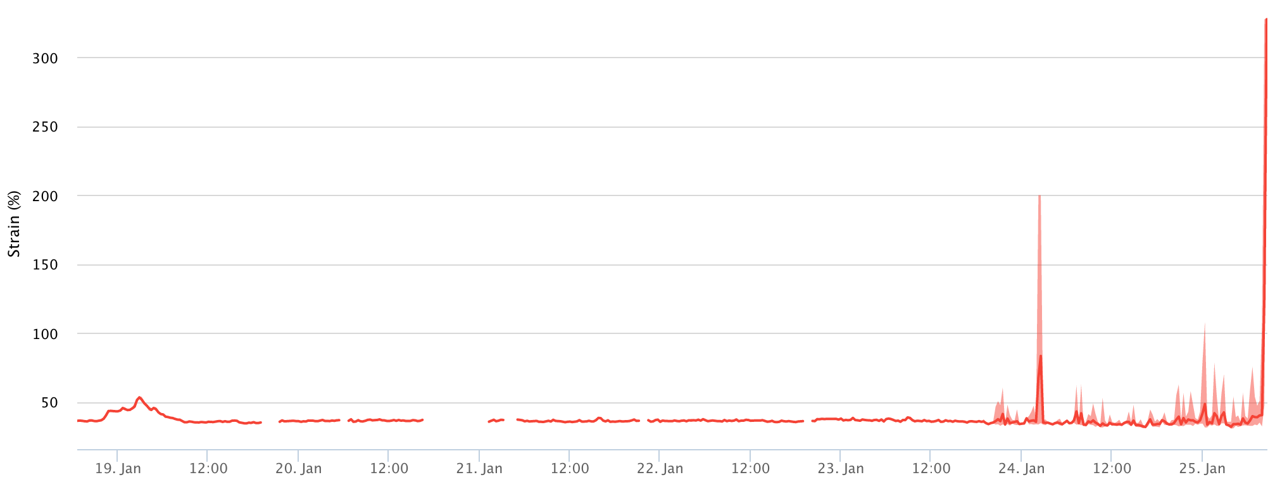
KAMYR Chip Meter after no data period
Data Shown:
January 18th to January 25th
Irregular Behavior Begins:
January 23rd, 2017

Slide 14
KAMYR Chip Meter isolate selected area

Slide 15
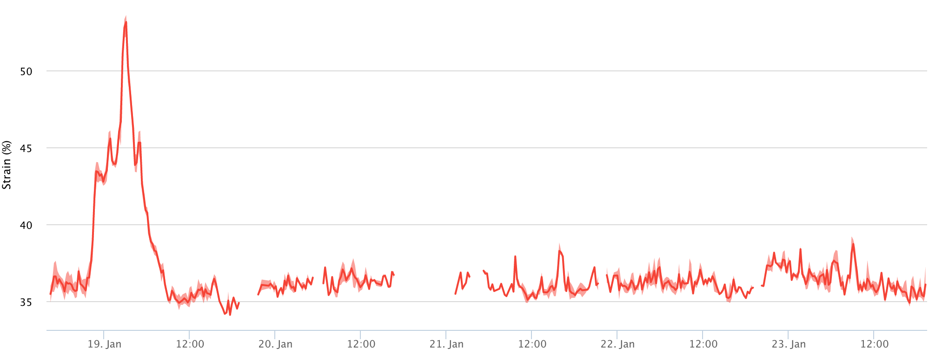
KAMYR Chip Meter isolated area - zoom
Data Shown:
January 18th to January 23rd
Isolated Peak:
January 19th

Slide 16
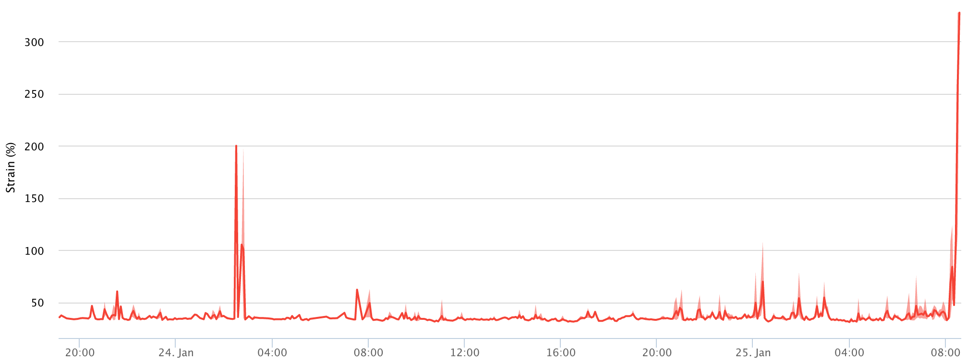
KAMYR Chip Meter isolated area – zoom
Data Shown:
January 23rd
to January 25th
Isolated Peaks:
January 24th
Saturated at 200%
January 25th
8:22 AM
Disconnect / Fail

Slide 17
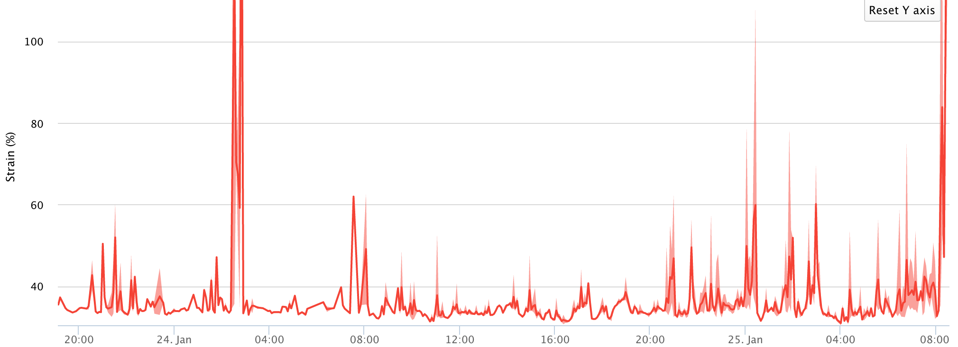
KAMYR Chip Meter isolated area - zoom
S
Peaks saturate at 200%
Disconnected
or
Failed

